Slide 1
Exchange User Group Berlin {Online Edition}
25. Mai 2020

Slide 2
Exchange Server Hybrid
Was ist das? Warum brauche ich das? Wie geht das?

Slide 3



Thomas Stensitzki
Enterprise Consultant Granikos GmbH & Co. KG MVP | MCT Regional Lead | MCSM @stensitzki thomas.stensitzki@granikos.eu

Slide 4
What is Exchange Hybrid?
Trusted relationship between an on-premises Exchange Organization and Exchange Online
Hybrid connections for mail flow (SMTP), and client access (HTTPS) for hybrid functionality
Hybrid Configuration Wizard (HCW) activates and configures the hybrid mode of operation
Microsoft 365
Hybrid Configuration
Exchange Online
On-Premises Exchange Organization

Slide 5
Exchange Hybrid Benefits
Free Busy lookups
No recreating of Outlook Profiles
Mailbox migrations without user interruption
Seamlessly connect to on-premises & Exchange Online
One Global Address List
Secure Mail Flow between on-premises & Exchange Online
Hybrid Modern Authentication
Cloud based archiving
And much more…

Slide 6
Exchange Hybrid | Two Variants – Three Modes
Hybrid Configuration
Classic
Express
Minimal
Modern
Minimal
Full
Full

Slide 7
Classic Full Hybrid
Microsoft 365
Active Directory Hybrid with Azure AD Connect
Exchange Hybrid enabled
SMTP Connection between On-Premises and Exchange Online
Separate hostname (e.g., smtp365.company.de)
Additional public IP address
TLS certificate for hostname
Edge Transport Role in perimeter network (A)
Alternatively, direct inbound connection (B)
Inbound HTTPS connection to Client Access Service
Published by Reverse Proxy
Additional public IP address
Outbound HTTPS connections to Exchange Online
Exchange Server
Hybrid Configuration
Exchange Online
Azure AD
B
A
HTTPS
SMTP
Perimeter Network
Company LAN
On-Premises Exchange Organization

Slide 8
Modern Full Hybrid
Microsoft 365
Active Directory Hybrid with Azure AD Connect
Exchange Hybrid enabled
SMTP Connection between On-Premises and Exchange Online
Separate hostname (e.g., smtp365.company.de)
Additional public IP address
TLS certificate for hostname
Edge Transport Role in perimeter network (A)
Alternatively, direct inbound connection (B)
Outbound HTTPS connections to Exchange Online
Exchange Hybrid-Agent (Exchange Online to Exchange on-premises communication)
Exchange Server
Hybrid Configuration
Exchange Online
Azure AD
B
A
HTTPS
SMTP
Perimeter Network
Company LAN
On-Premises Exchange Organization

Slide 9


Exchange Hybrid – The Differences
Full
Full classic hybrid configuration, Exchange server published to the internet (SMTP/HTTPS) → permanent hybrid operation
Minimal
Hybrid configuration, without rich coexistence to migrate all on-premises mailboxes to Exchange Online → temporary hybrid operation for a few weeks / months
Express
Hybrid configuration, with Azure AD Connect Express settings, to migrate all on-premises mailboxes to Exchange Online → temporary hybrid operation for a few days / weeks
Full
Full Modern Hybrid configuration, for new hybrid setups based on Hybrid Agent deployment, with reduced hybrid functionality → permanent hybrid operation
Minimal
Modern Hybrid configuration, to migrate all on-premises mailboxes to Exchange Online → temporary hybrid operation for a few weeks / months

Slide 10
Exchange Server Hybrid
Was ist das? Warum brauche ich das? Wie geht das?

Slide 11
Why do you need Exchange Hybrid?
Coexistence between on-premises Exchange Organization & Exchange Online
Mailbox migration to/from Exchange Online
Microsoft Teams with on-premises mailboxes
Transition from on-premises Exchange to Exchange Online
Optimal migration experience for end users
Centralized mail flow for use of on-premises mail solutions and cloud-hosted mailboxes
Gateway-based S/MIME de-/encryption, disclaimer, archiving, journaling, …
Hybrid mail flow providing Exchange relay functionality for on-premises legacy applications and devices
No access to the internet
No support for TLS connection encryption
No support for user authentication

Slide 12
Exchange Hybrid and Microsoft Teams
On-Premises Exchange Server 2016 / 2019 hybrid endpoint
Microsoft Teams backend uses AutoDiscover v2
Client Access Endpoint for Microsoft Teams backend services
Always run latest Exchange Server cumulative update
Use Third-Party TLS-certificate
Enable Hybrid Modern Authentication
AutoDiscover public DNS resource records for SMTP domains

Slide 13
Exchange Server Hybrid
Was ist das? Warum brauche ich das? Wie geht das?

Slide 14
Exchange Hybrid Requirements
Know the different hybrid variants and modes
Know your target operation mode for Exchange hybrid
Have your on-premises Exchange organization in good shape
Latest cumulative updates installed
Verify inbound connectivity to your Exchange organization using Remote Connectivity Analyzer
Have required IP addresses & DNS host names set up
Edge Transport Server is subscribed to the Active Directory Site
Have Edge TLS certificates installed on internal Exchange Servers for selection by HCW
Not enabled for any Exchange service

Slide 15
Hybrid Configuration Wizard
Exchange Server Requirements
Exchange 2010 SP3 + latest Update Rollup
Exchange 2013 CU1 or later
Exchange 2016 and Exchange 2019
→ Supported modern Exchange Server setup requires latest CU (or N-1)
Click-2-Run Setup
https://aka.ms/HybridWizard
Ensure that .application file extension is mapped to Internet Explorer
Current Version 17.x
Uninstall HCW 16.x first
Verify that WinRM service is running and not controlled by GPO

Slide 16
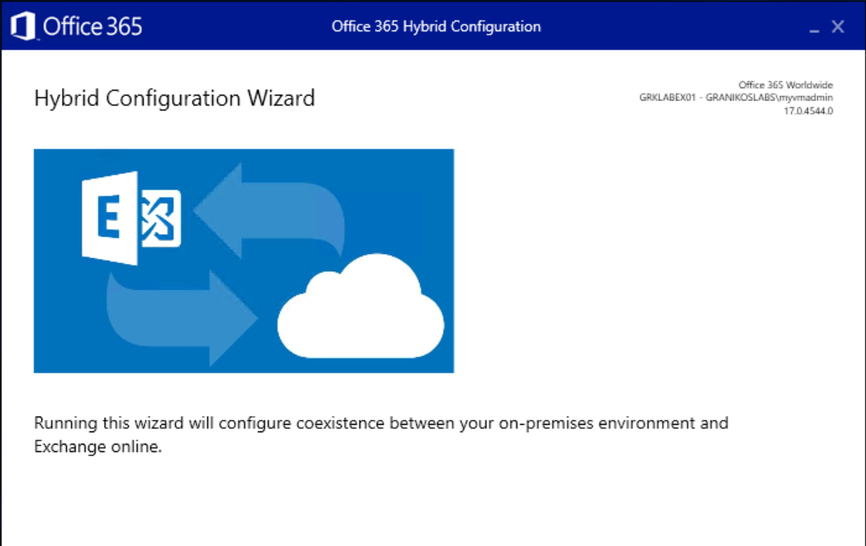
Hybrid Configuration Wizard
Note the HCW version information
HCW is updated regularly

Slide 17
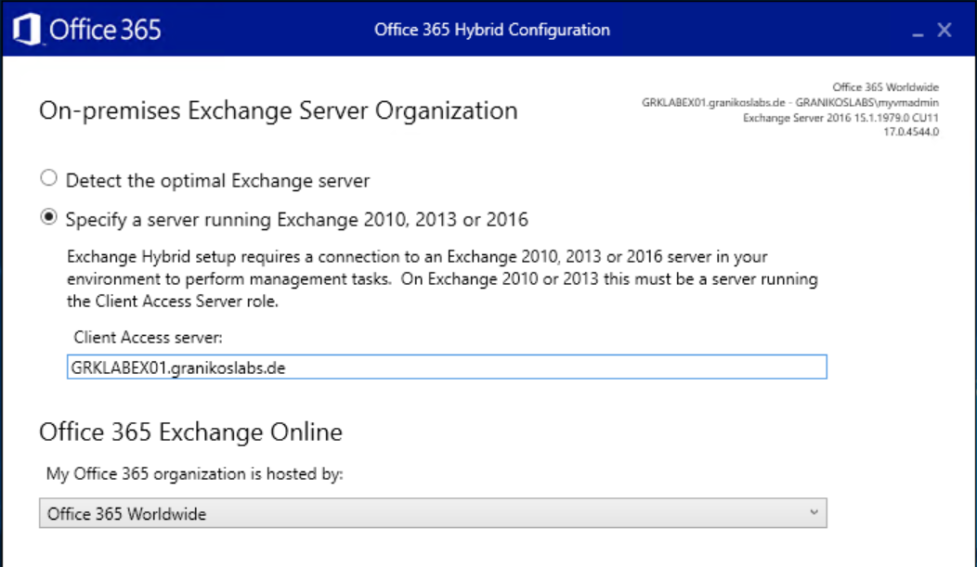
Hybrid Configuration Wizard
On-Premises Exchange Server Organization
Optimal Exchange Server detected by HCW
Specify a CAS server manually, if needed
Select Office 365 target infrastructure

Slide 18
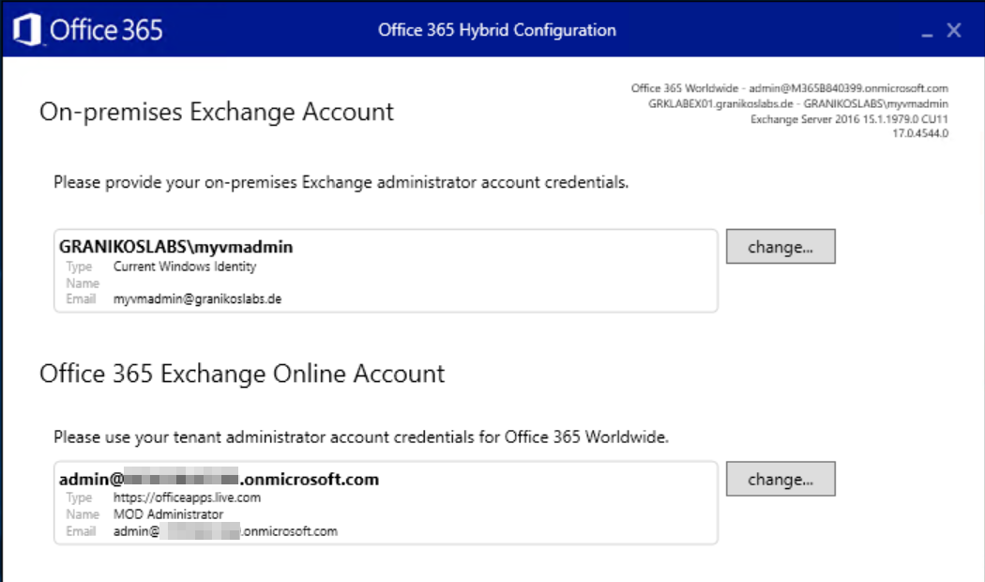
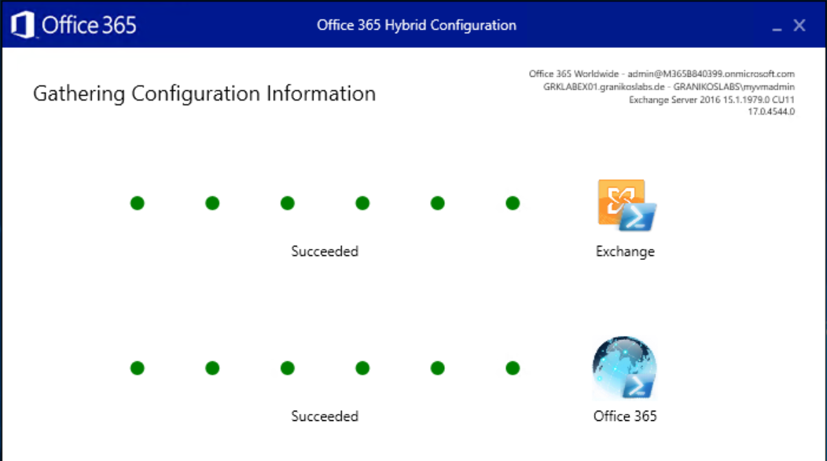
Hybrid Configuration Wizard
Administrative Exchange Accounts
Connect to on-premises Exchange and Exchange Online
Adjust credentials as needed
Check, if WinRM allows Basic Authentication

Slide 19
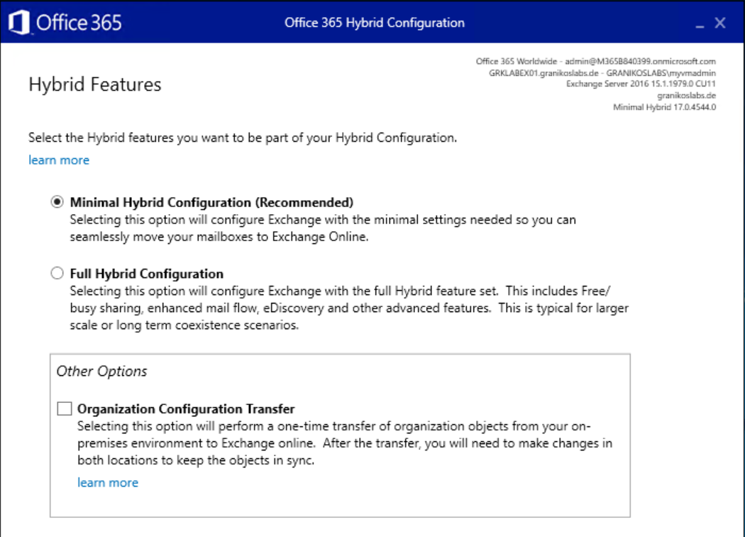
Hybrid Configuration Wizard
Hybrid Features
Select hybrid features
Minimal Hybrid
Full Hybrid
Enable Organization Configuration Transfer
One-time transfer of selected configuration objects

Slide 20
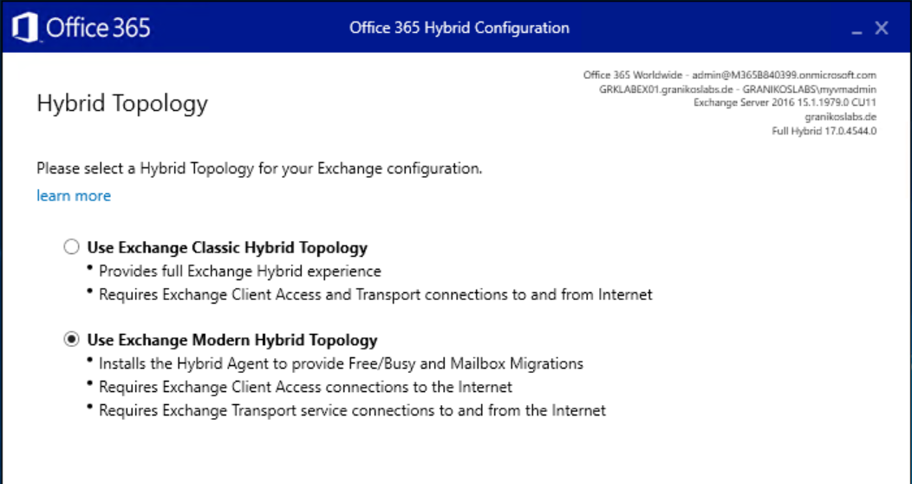
Hybrid Configuration Wizard
Hybrid Topology
Select Hybrid Topology
Classic Hybrid
Modern Hybrid

Slide 21
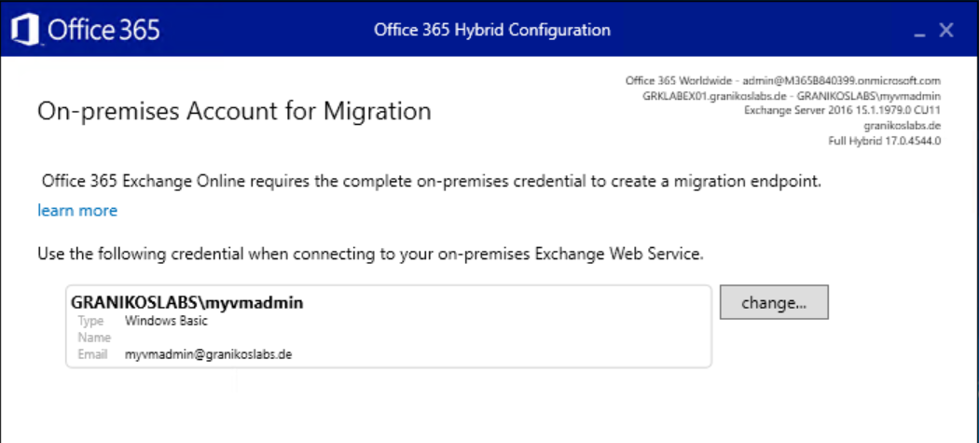
Hybrid Configuration Wizard
Migration Account
Configure credentials for on-premises Exchange Web Service Endpoint
Used for mailbox migrations

Slide 22
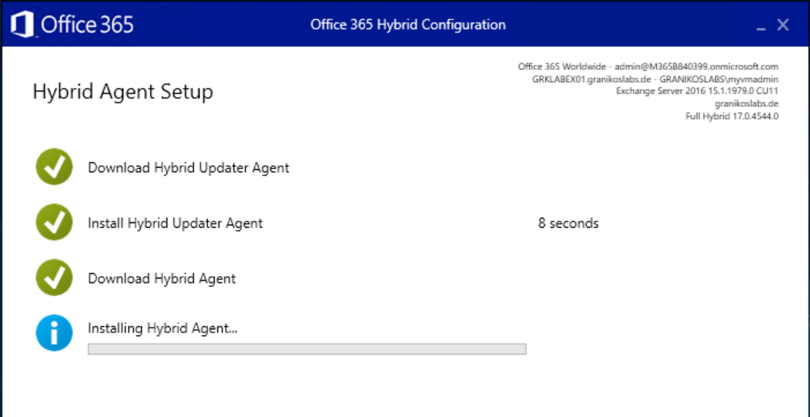
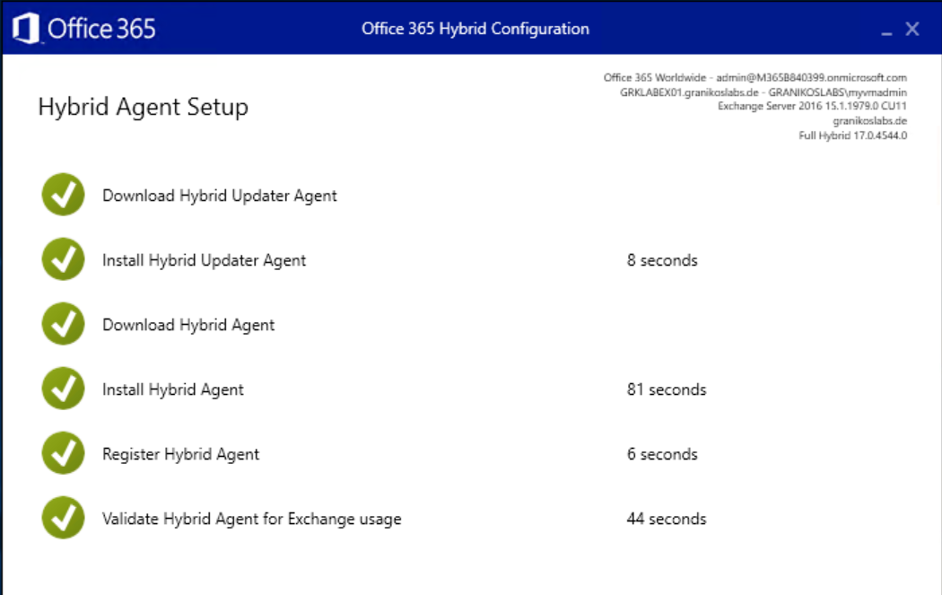
Hybrid Configuration Wizard
Hybrid Agent Setup
Hybrid Agent Setup starts automatically
Download and install of Hybrid Updater
Download and install of Hybrid Agent

Slide 23
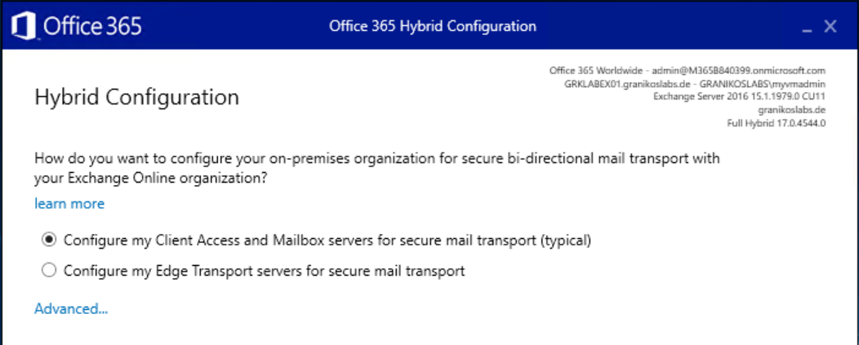
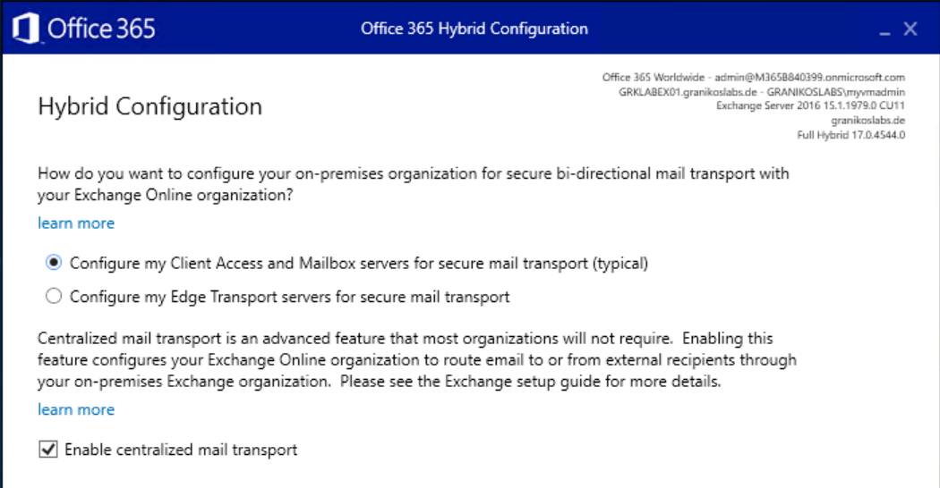
Hybrid Configuration Wizard
Hybrid Mail Flow
Configure hybrid mail flow
Direct to/from internal Exchange Servers
Edge Transport Servers in perimeter network
Centralized mail flow
Route all mail flow to/from Exchange Online via on-premises Exchange Organization

Slide 24
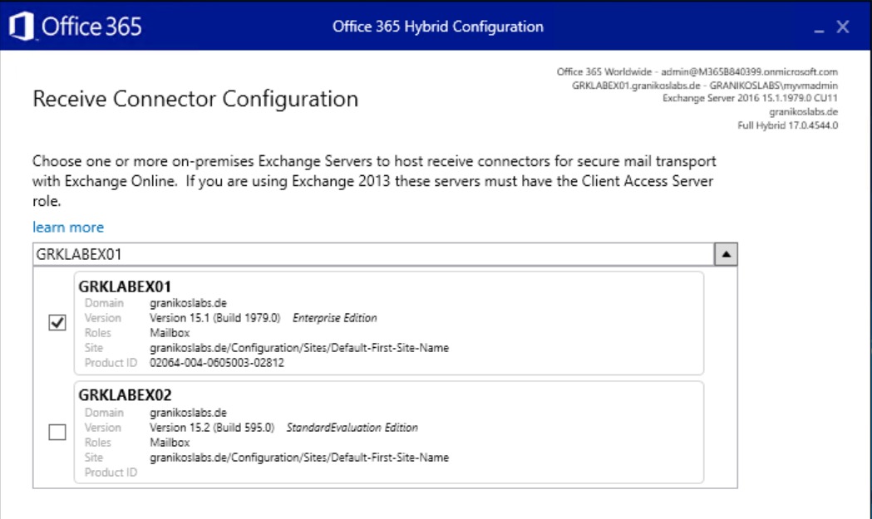
Hybrid Configuration Wizard
Receive Connectors
Select Exchange server used for receiving email messages from Exchange Online
Select the Exchange Server published to the Internet
HCW configures the receive connector

Slide 25
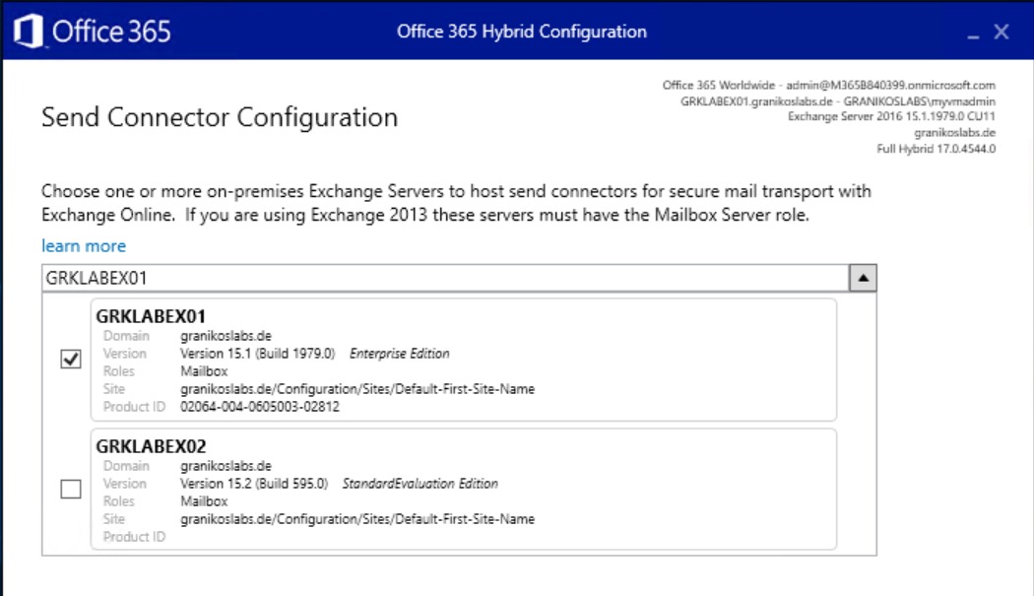
Hybrid Configuration Wizard
Send Connectors
Select Exchange server for sending email messages from the on-premises Exchange Organization to Exchange Online
HCW configures Send Connectors
Server needs outbound connectivity to Exchange Online

Slide 26
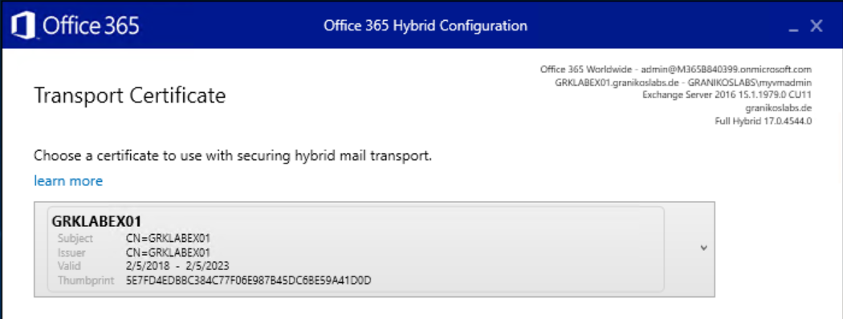
Hybrid Configuration Wizard
Transport Certificate
Select TLS certificate to secure the trusted mail flow between on-premises Exchange and Exchange Online
With Edge Transport
Ensure that the dedicated TLS certificate is installed in the certificate store of one of the internal Exchange servers
Do NOT enable the TLS certificate for any Exchange service

Slide 27
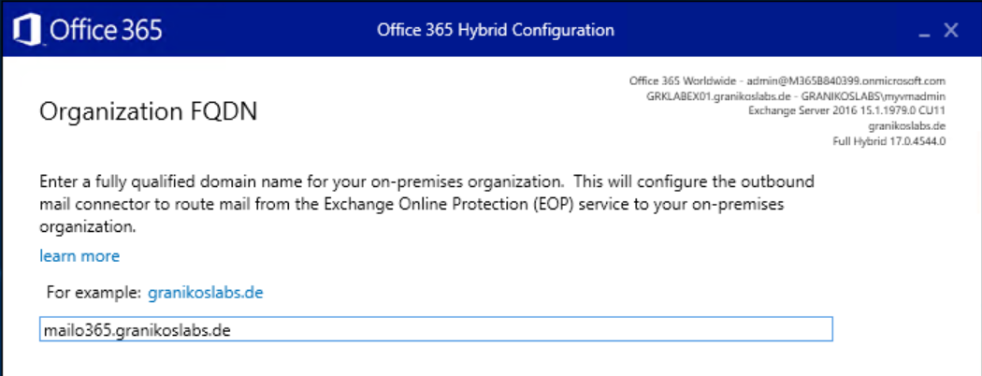
Hybrid Configuration Wizard
Inbound SMTP Host Name
Enter the external FQDN of the Exchange Organization
Hostname should match TLS certificate

Slide 28
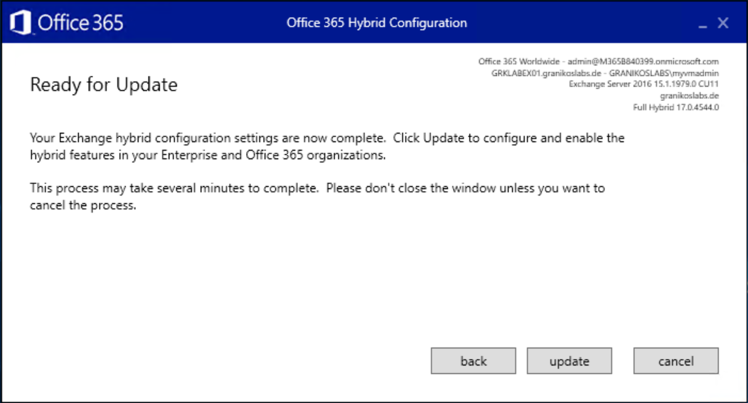
Hybrid Configuration Wizard
Ready for Update
Update and wait
If it fails
HCW provides access to full log files
All configuration steps documented
Remote Connectivity Analyzer to check inbound connectivity
Issues
Remote connectivity
→ Firewall, Proxy, DNS
WinRM Windows service configuration issues

Slide 29


Q & A
Supportende
13. Oktober 2020

Slide 30
Ressourcen
Exchange Server Hybrid Deployments
Hybrid Deployment Prerequisites
Hybrid Configuration Wizard FAQs
How to configure Exchange Server on-premises to use Hybrid Modern Authentication
How Exchange and Microsoft Teams interact
Configure OAuth authentication between Exchange and Exchange Online organizations
Remote Connectivity Analyzer

